Slide 1

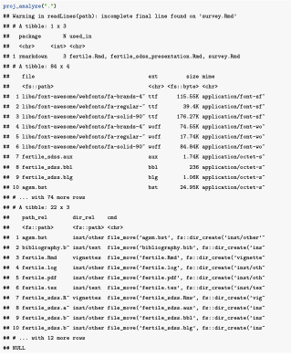

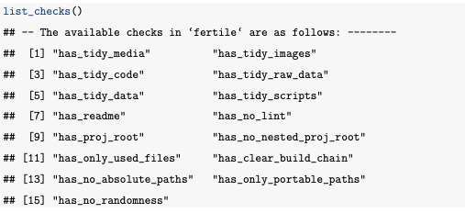
Creating optimal conditions for reproducible data analysis in R with fertile
Audrey Bertin, ‘21 and Ben Baumer, Asst. Prof. of Statistical and Data Sciences
Statistical & Data Sciences Program, Smith College, Northampton, MA 01063
Introduction
Methods
• A project is reproducible when the code and data files produce identical results when run by another analyst
• Reproducibility is becoming increasingly important!
→ Research more data driven
→ Internet allowing for faster idea sharing
→ W/O reproducibility, can’t judge others’ findings, advance ideas quickly, or receive good feedback on work.
• However, in published literature:
→ Components of reproducibility up for discussion
→ Recommendations vary significantly
Fertile operates in two modes:
1) Proactively: preventing reproducibility mistakes from happening in the first place
2) Retroactively: analyzing code that has already been written for potential problems
• A project is reproducible when the code and data files produce identical results when run by another analyst
• Reproducibility is becoming increasingly important!
→ Research more data driven
→ Internet allowing for faster idea sharing
→ W/O reproducibility, can’t judge others’ findings, advance ideas quickly, or receive good feedback on work.
• But in literature, there is uncertainty over which components are most important and recommendations vary significantly
Proactive Use
• Fertile identifies mistakes and outputs an informative message and often a recommended solution.
• Focuses on file paths, ensuring that any time the user calls a path that it is reproducible – not absolute or leading outside the directory
Retroactive Use
• With two main functions, proj_analyze() and proj_check(), users can very easily get a summary on many different reproducibility aspects
• proj_analyze(): gives information on packages called in
code, file structure, recommendations for reorganizing files,
and a list of non-reproducible file paths referenced in code
• proj_check() runs 15 different checks on an R project
covering additional reproducibility aspects, like
randomness, documentation, and readable code.
The available checks are listed below:
Goals
• Avoid generalization by focusing on reproducibility in Rstudio projects:
→ Very popular for data analysis
→ Easily accessible for all users
• Develop an R package that achieves the following:
→ Rather than focusing on specific areas of reproducibility, give general feedback.
→ Be accessible to users of all skill levels with minimal effort
→ Help educate users about why their work is not reproducible w/ the goal of educating on reproducibility

